Slide 1
Domain-Driven Design (DDD)

Slide 2
Concepts and Overview
Domain-Driven Design
  is an approach to the design of software, based on the two premises:
    That complex domain designs should be based on a model.
    For most software projects, the primary focus should be on the domain and domain logic (as opposed to being the particular technology used to implement the system)
      No more Datasets, Data Reader, etc.
      Use classes for Entity Objects

Slide 3
Main advantage of DDD
The Design is focus on business rather than Technology
In practice DDD seeks to exploit the powerful advantages that object-oriented techniques make possible.
Code is easy to re-use and readable.
Code is flexible enough for major enhancements

Slide 4
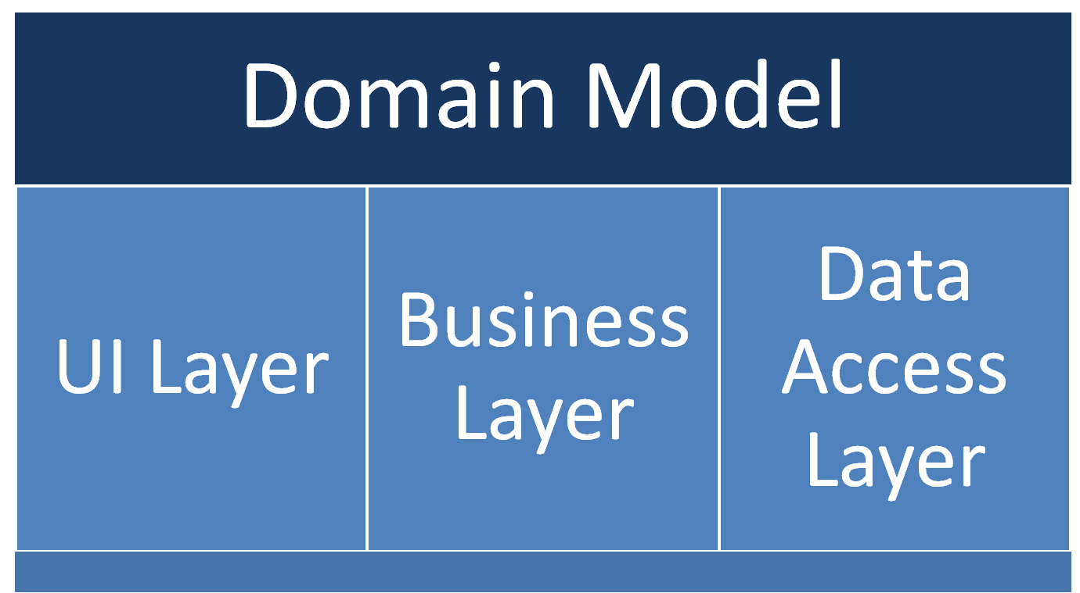
Domain-Driven Application
Architecture

Slide 5
Technical Implementation
Domain-Model
POJOs
  Plain Old Java Objects
POCOs
  Plain Old CLR Object
POJOs and POCOs
  are technical implementation concepts, specific to the Java and .NET framework respectively. framework.
  They contain Properties only to hold data.
  No more Methods as compare with Smart Entity.

Slide 6
Sample Smart Entity
A Class with Properties and Methods which act as business layer at the same time
Public class AccountInfo
private string _accountNo;
private string _accountName;
public AccountNo {
get { return _accounNo}
set { _accountNo = value;}
}
public AccountName {
get { return _accounName}
set { _accountName = value;}
}
public Void Deposit()
{}
public Decimal GetBalance()
{}
}

Slide 7
Sample POCO
A Class with Properties a
Public class AccountInfo
private string _accountNo;
private string _accountName;
public AccountNo {
get { return _accounNo}
set { _accountNo = value;}
}
public AccountName {
get { return _accounName}
set { _accountName = value;}
}
}

Slide 8
Exercise
Create Entity for TPR
Name the Project as IPOTeams.TPR

